Slide 1

Integrity Introspection for Scientific Workflows (IRIS)
Funded by the National Science Foundation
Grant #1839900
Anirban Mandal, Yufeng Xin, Erica Fu, Ilya Baldin (RENCI, UNC – Chapel Hill)
Ewa Deelman, Mats Rynge, Karan Vahi, Ryan Tanaka (USC/ISI)
Von Welch, Ishan Abhinit (Indiana University)
Drew Angerer, Getty Images

Slide 2
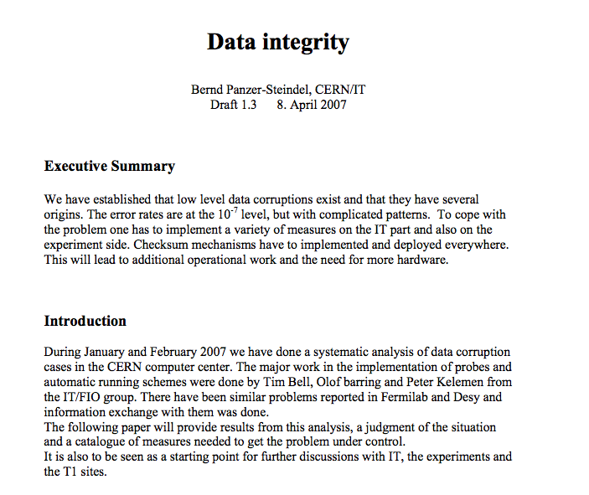
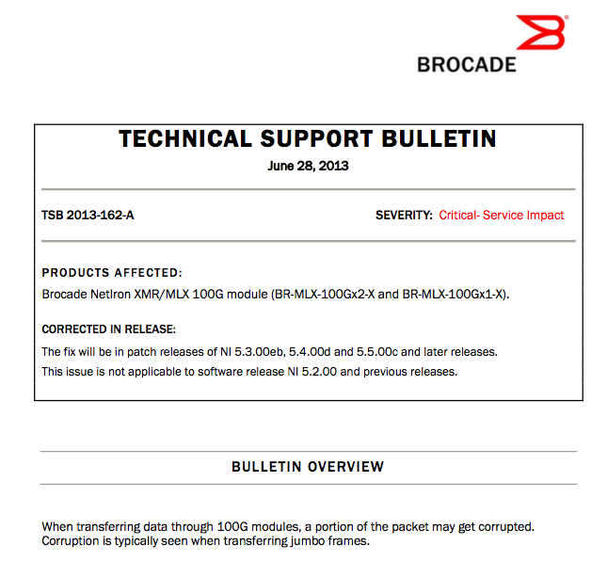
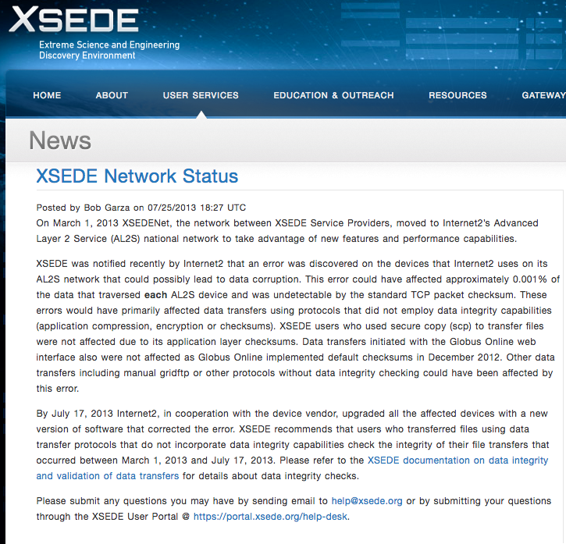

Challenges to Scientific Data Integrity
Modern IT systems are not perfect - errors creep in.
CERN/NEC Studies of Disk Errors
“The error rates are at the 10⁻⁷ level, but with complicated patterns.” E.g. 80% of disk errors were 64k regions of corruption.
Software failures
Bug in StashCache data transfer software would occasionally cause silent failure (failed but returned zero). 10 CPU-years of computing lost.
Network Corruption
Network router software inadvertently corrupts TCP data and/or checksum!
The CICI SWIP project incorporated integrity checking in Pegasus making sure that workflow computations are protected from integrity errors.
XSEDE and Internet2 example from 2013.
Notes:
So why is this problem important ? What are the challenges to scientific data integrity? Unfortunately, modern IT systems are not perfect and unintentional integrity errors creep in into our distributed execution platforms and systems; Even if users might think that they are protected through mechanisms like TCP checksums, checksum validation, encrypted transfers or RAID and erasure coding, unintentional integrity errors do happen in the infrastructure and this slide provides evidences of such errors that have happened in different contexts.

Slide 3
IRIS: Challenges and Approach
Scientific workflow processing sometimes suffers from data integrity errors when executed on distributed cyberinfrastructure (CI).
Lack of tools that can collect and analyze integrity-relevant data and hence, errors go undetected and corrupt data becomes part of the scientific record.
Develop an integrity introspection framework that collects integrity data and utilizes ML algorithms to automatically detect, analyze and pinpoint source of integrity errors.
Train ML algorithms on controlled testbeds and validate on national CI by integrating framework with Pegasus.
Engage with science application partners in gravitational-wave physics, earthquake science, and bioinformatics to deploy the analysis framework.

Slide 4
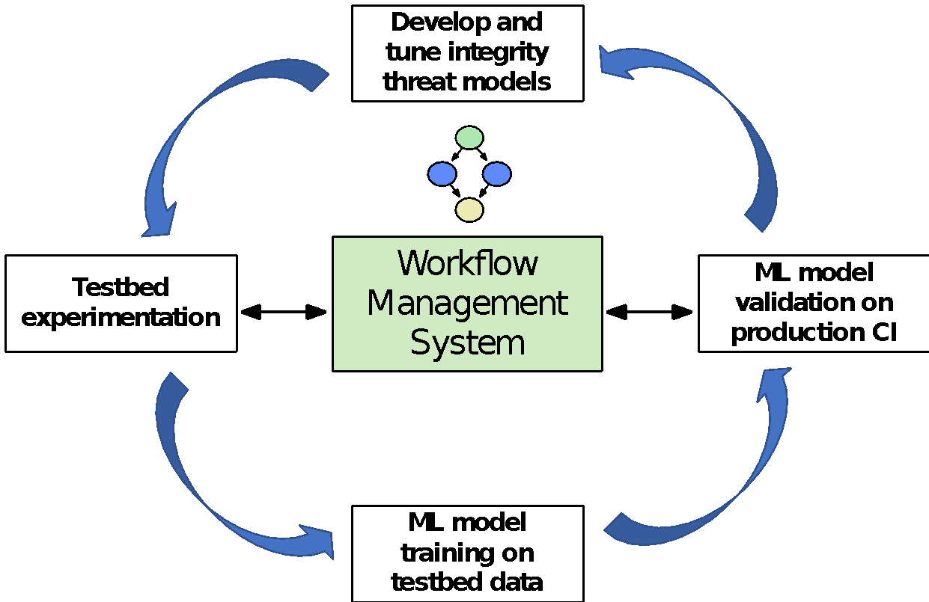
IRIS Approach and Accomplishments
Goal: Detect, diagnose, and pinpoint the source of unintentional integrity anomalies in scientific workflow executions on distributed cyberinfrastructure.
Threat Model development
Developed threat models for anticipated integrity issues based on Open Science Cyber Risk Profile (OSCRP). Available at
http://hdl.handle.net/2022/23225
Integrity Data Collection
Developing new capabilities in Pegasus to collect integrity-related metrics: new composite job event that triages information from (a) job ‘kickstart’ output, (b) job stdout and stderr, (c) job transfers, and (d) per file checksum.
Testbed Experimentation
In order to simulate different types of sources of storage integrity errors, we added a new utility in Chaos Jungle.
Github link: https://github.com/RENCI-NRIG/chaos-jungle/tree/storage/storage
Integrity Data Analysis
Combine workflow and incomplete infrastructure features: ML inference from end-to-end flow integrity checks with training data generated with fault injection. Cast it as a network system Root Cause Analysis (RCA) problem.
Notes:
Developed threat models for anticipated integrity issues based on OSCRP. OSCRP is an asset/impact-oriented approach that starts with the identification of assets that open science projects have and what harm could befall on those assets, and what the impacts from those harms would be to the project. We start with identifying the stakeholders of the project, then creating an asset inventory by looking through the list of “Common Open Science Assets.” Then, for each asset, we examine the concerns, consequences and avenues of attack.
We simulate portions of the threat model using the Chaos Jungle software that introduces different kinds of impairments into the virtual infrastructure - network, compute, storage, instantiated on a testbed like ExoGENI. For IRIS, we developed injection of different kinds of storage errors.
We enhanced the Pegasus data collection framework to collect more fine grained integrity-related data with a new composite event that triages information from multiple sources of job related data.

Slide 5
Integrity Threat Models
We developed the “Data Integrity Threat Model”, which applies Open Science Cyber Risk Profile to determine the threats that are in scope for the IRIS project.
OSCRP is an asset/impact-oriented approach that starts with the identification of assets that open science projects have and what harm could befall on those assets, and what the impacts from those harms would be to the project.
The Data Integrity Threat Model undertakes first four steps of the OSCRP profile. We start with identifying the stakeholders of the project, then creating an asset inventory by looking through the list of “Common Open Science Assets.”
Then, for each asset, we examine the concerns, consequences and avenues of attack. Next, for each relevant concern, avenues of attack that could cause the concern to be realized are noted.

Slide 6
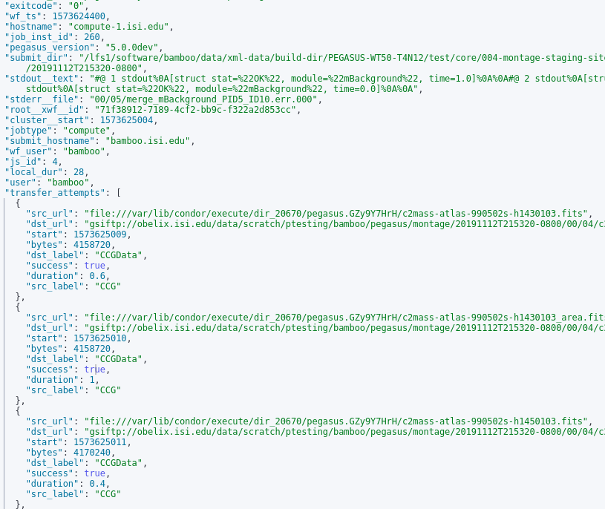
Integrity Data Collection
IRIS requires new capabilities in Pegasus to automatically collect, triage and stream transfer and integrity related metrics from the workflows
Need information at a job level that has information merged from various sources, and at a much greater detail than previous workflow provenance collected

Slide 7
Integrity Data Collection
Leverage existing capabilities to send events to an AMQP endpoint, with an Elastic Search backend
New composite job event, sent once per job that triages information from various sources
Job kickstart record
Job stdout and stderr
Transfers attempted, with metadata such as start time, duration, source, and destination
Per file checksum metadata, both for validating existing checksums as well as generating checksums for produced data

Slide 8
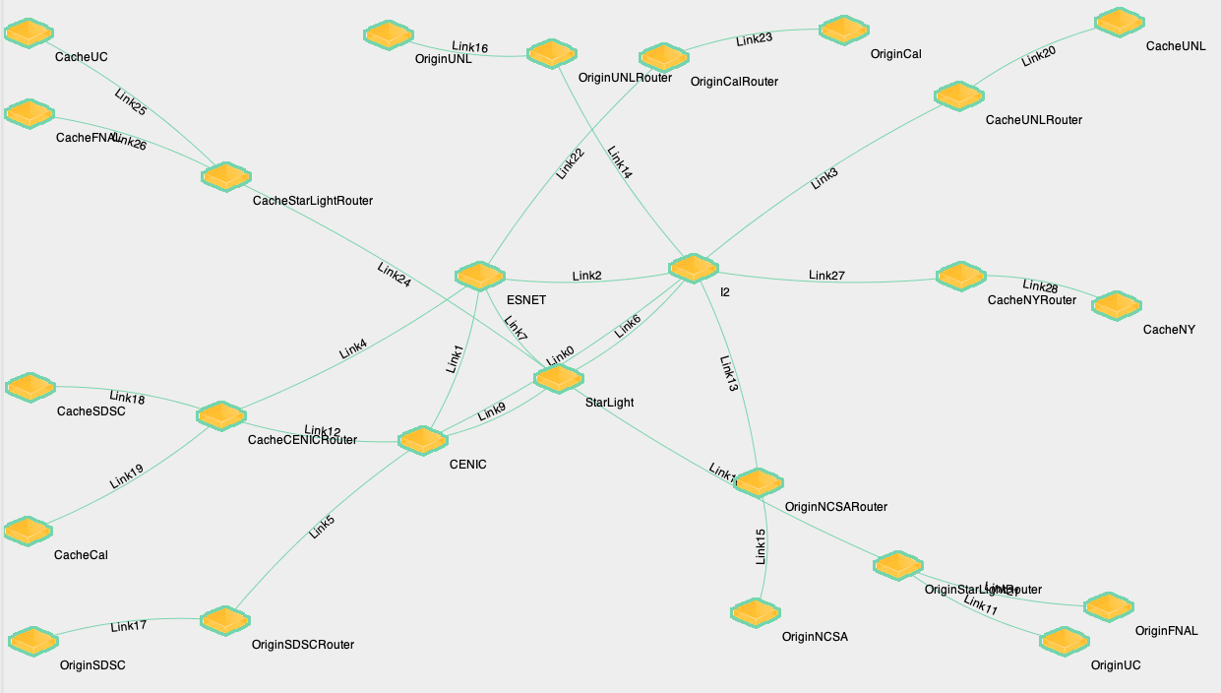
Chaos Jungle: Testbed Experimentation
Experiment on ExoGENI
X: Storage integrity error injection. Randomly select file(s) and corrupting by inverting 1 bit.
X: Network interface corruption. Using eBPF to swap bytes in TCP
Data transfers
Dest node check if corruption
detected in the data from each src nodes
Produce a corruption matrix using results from dest nodes
X
X
X
X
X

Slide 9
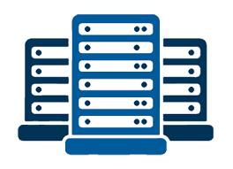



Network System Root Cause Analysis
Work in Progress: Emulating content distribution networks (CDN) on ExoGENI and injecting integrity errors with Chaos Jungle. The emulated system is inspired by science data flows/distribution on the Open Science Grid (OSG).
X: Chaos Jungle integrity error injection
X
s1
X
Gathering training data with several features.
Labels are infrastructure entities (links, compute nodes, caches, storage nodes) responsible for root cause of integrity error.
ML analysis of data and model development are ongoing.
d1
N5
N1
c1
Compute Site 1
X
d2
I2
N2
c2
s2
N6
N3
d3
N4
X
X
Network
c3
d4
Compute Site 2
Data Origin Sites
Notes:
Inspired by integrity errors found in the SWIP project;
Talk about future work; Science applications tie-in and evaluate the ML models on production cyberinfrastructure with Pegasus science workflows.

Slide 10
Integrity Data Analysis: Cast as Network RCA Problem
Traditional Model Based
System models: Cluster, Network switches and links, and Client
Path <- mapping -> links
Symptoms -> system components
Machine Learning
Topology (partially) unknown
Routes unknown
Infer from end-to-end flow-level monitoring to components
Flows
Links/Interfaces/Nodes
F₁
L₁
F₂
L₂
?
.
.
.
.
.
.
F_{i}
L_{j}
.
.
.
.
.
.
F_{n-1}
L_{k-1}
F_{n}
L_{k}

Slide 11
Integrity Data Analysis: RCA Data Challenges and Design Space
Failure mode
Hard failure | Gray Failure
Topology information
Complete | Incomplete
Flows
All Node Pair | End Hosts Only
Flow Routing
Complete | Unknown
Monitoring
Active Probe | Passive monitoring
System
Production | Emulation
Fault
Passive monitoring | Injection

Slide 12
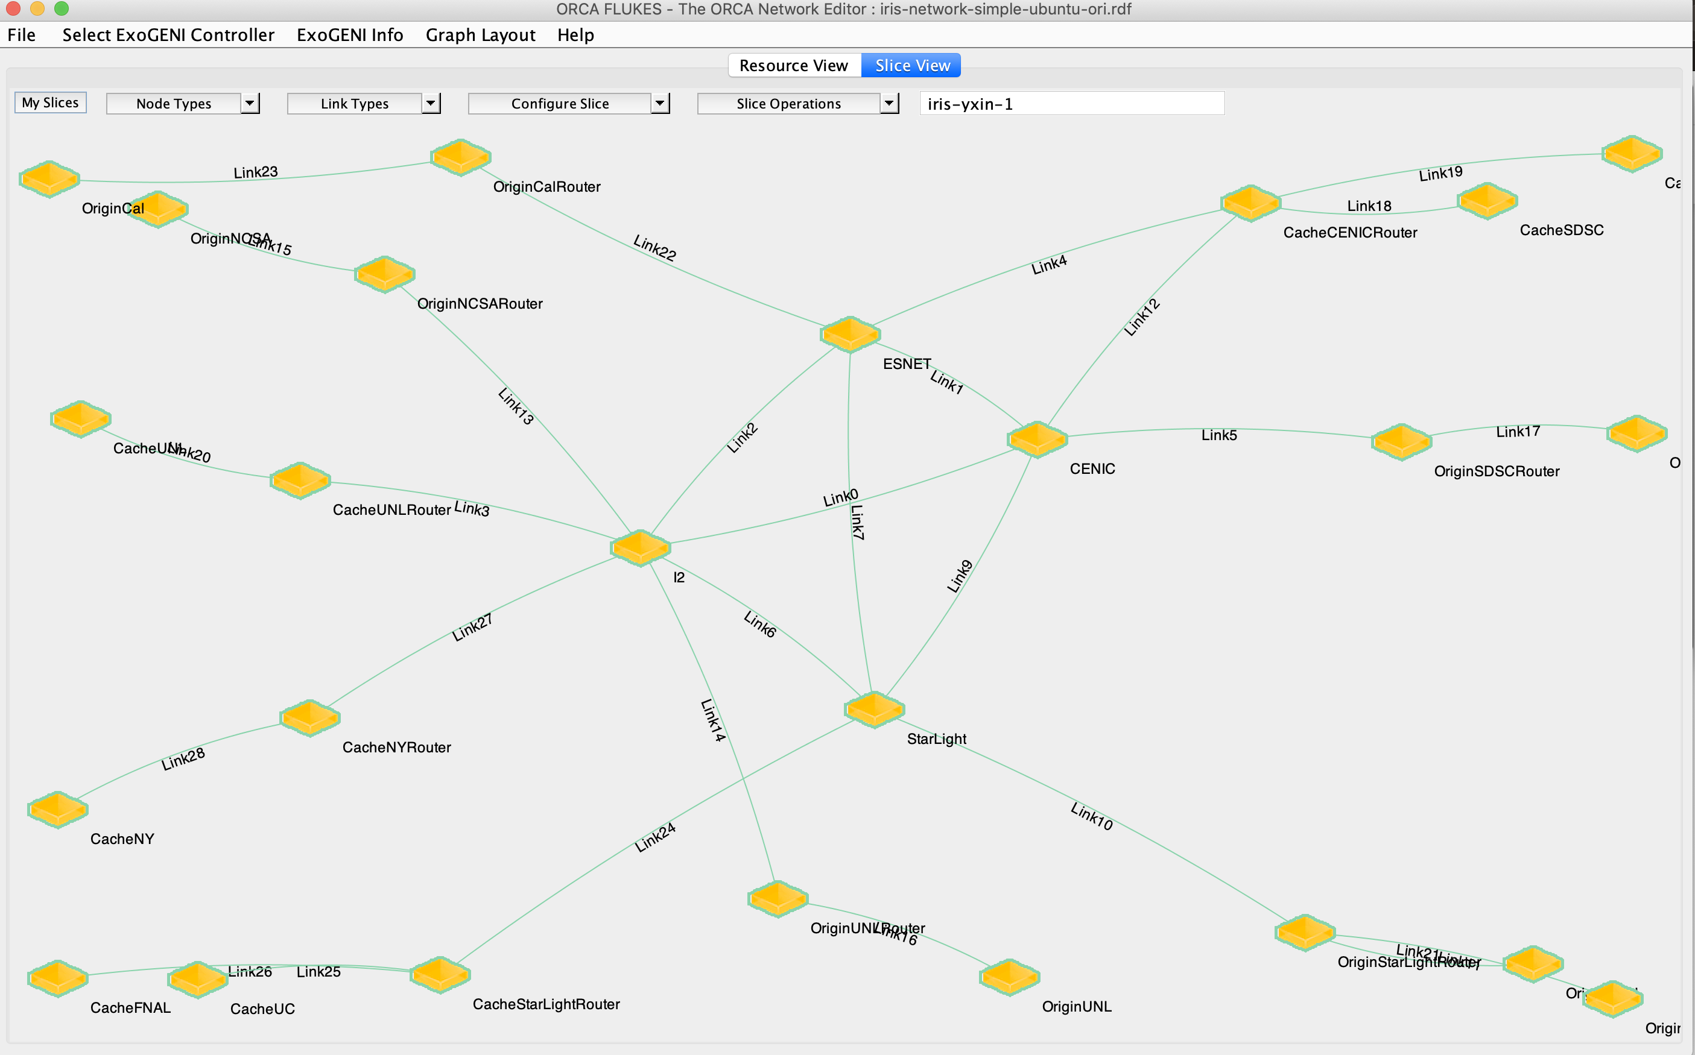
Integrity Data Analysis: Experiment Automation
1. Experiment automation:
Postboot script
Automated OSPF Configuration
2. Fault injection and Data Collection Automation
Chaos Jungle injection on both router and host nodes
Data collection
3. Analysis and ML modeling in Jupyter

Slide 13
Integrity Data Analysis: Decision Tree Multi-Label Classification

Slide 14
Integrity Data Analysis: SVC Multi-Label Classification

Slide 16
BN Training time: 427 ms, 115 ms

Slide 17
Funded by the National Science Foundation
Grant #1839900
Thank you !!
Questions ?

Slide 18
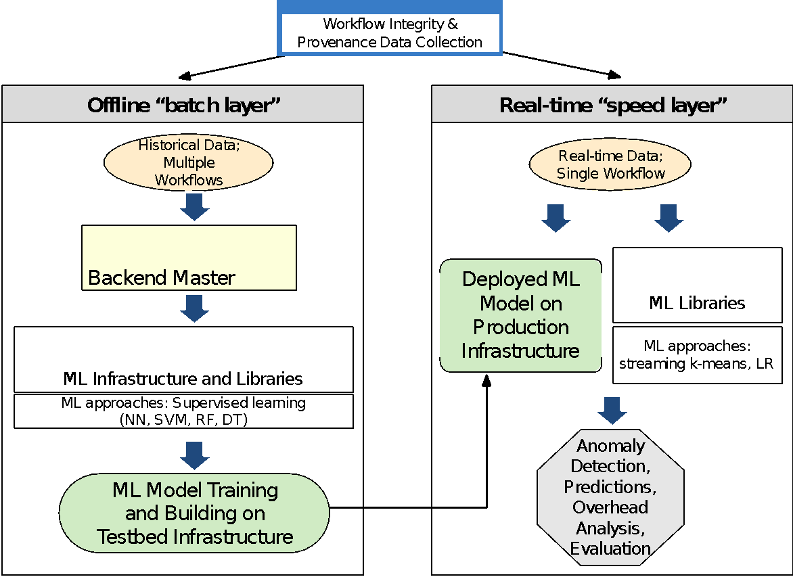
IRIS Project Overview
Challenges:
Scientific workflow processing sometimes suffers from data integrity errors when executed on distributed cyberinfrastructure (CI).
Lack of tools that can collect and analyze integrity-relevant data and hence, errors go undetected and corrupt data becomes part of the scientific record.
Broader Impact:
The IRIS integrity introspection framework will be available to a broad range of domains that rely on Pegasus.
IRIS will contribute to the discussions on reproducibility since integrity is essential to supporting reproducibility.
Integrity-relevant data collected in IRIS and ML algorithms developed can be used by students and researchers.
Deliverables:
Develop an integrity introspection framework that collects integrity data and utilizes ML algorithms to automatically detect, analyze and pinpoint source of integrity errors.
Train ML algorithms on controlled testbeds and validate on national CI by integrating framework with Pegasus.
Engage with science application partners in gravitational-wave physics, earthquake science, and bioinformatics to deploy the analysis framework.
Metadata tag:
<https://sites.google.com/view/iris-nsf/>
<Application of ML for integrity analysis>
<Looking for different sources of integrity data: infrastructure and application>
<Builds on CICI SWIP project, by adding detection and analysis of integrity errors>
Notes:
science drivers for your project and scientific impact. As with other presentations during the PI Workshop, we would like to hear about the challenges faced by the project and lessons learned. Below is the general timeline for the panel.

